Slide 1
Chapter 7: Modifiability
Pingjian Zhang
School of Software Engineering, SCUT
2018

Slide 2
Chapter Outline
What is Modifiability?
Modifiability General Scenario
Tactics for Modifiability
A Design Checklist for Modifiability
Summary

Slide 3
不变的是变化
灵活性
伸缩性
可移植
可重构
开放性
生产线
…

Slide 4
What is Modifiability?
Modifiability is about change and our interest in it is in the cost and risk of making changes.
To plan for modifiability, an architect has to consider three questions:
What can change?
What is the likelihood of the change?
When is the change made and who makes it?

Slide 5
Modifiability General Scenario
Portion of Scenario | Possible Values
Source | End user, developer, system administrator
Stimulus | A directive to add/delete/modify functionality, or change a quality attribute, capacity, or technology
Artifacts | Code, data, interfaces, components, resources, configurations, …
Environment | Runtime, compile time, build time, initiation time, design time
Response | One or more of the following: make modification test modification deploy modification
Response Measure | Cost in terms of: number, size, complexity of affected artifacts effort calendar time money (direct outlay or opportunity cost) extent to which this modification affects other functions or quality attributes new defects introduced

Slide 6
Sample Concrete Modifiability Scenario
The developer wishes to change the user interface by modifying the code at design time. The modifications are made with no side effects within three hours.

Slide 7
Goal of Modifiability Tactics
Tactics to control modifiability have as their goal controlling the complexity of making changes, as well as the time and cost to make changes.

Slide 8
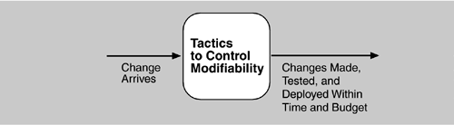
Goal of Modifiability Tactics

Slide 9
Modifiability Tactics

Slide 10
Reduce Size of a Module
Split Module: If the module being modified includes a great deal of capability, the modification costs will likely be high. Refining the module into several smaller modules should reduce the average cost of future changes.

Slide 11
Increase Cohesion (SRP)
Increase Semantic Coherence: If the responsibilities A and B in a module do not serve the same purpose, they should be placed in different modules. This may involve creating a new module or it may involve moving a responsibility to an existing module.
Notes:
挤出不相关的东西

Slide 12
Reduce Coupling (OCP)
Encapsulate: Encapsulation introduces an explicit interface to a module.
Use an Intermediary: Given a dependency between responsibility A and responsibility B, the dependency can be broken by using an intermediary.

Slide 13
Reduce Coupling
Restrict Dependencies: restricts the modules which a given module interacts with or depends on.
Refactor: undertaken when two modules are affected by the same change because they are (at least partial) duplicates of each other.
Abstract Common Services.

Slide 14
Defer Binding
In general, the later in the life cycle we can bind values, the better.
If we design artifacts with built-in flexibility, then exercising that flexibility is usually cheaper than hand-coding a specific change.
However, putting the mechanisms in place to facilitate that late binding tends to be more expensive.

Slide 15
Design Modifiability
Adopt suitable architectural patterns and tactics.
Design a dedicated modifiability view if necessary.
Build a modifiability model if possible by introducing some measures.

Slide 16
Design Modifiability
Determine which changes or categories of changes are likely to occur. For each potential change or category of changes
Determine the responsibilities that need to add, modify, or delete to make the change.
Determine what other responsibilities are impacted by the change.
Allocate responsibilities that will be changed together in the same module, and responsibilities that will be changed at different times in separate modules.

Slide 17
Design Modifiability
Determine which functionality or quality attribute can change at runtime and how this affects coordination. If so, ensure that such changes affect a small number set of modules.
Determine which devices, protocols, and communication paths used for coordination are likely to change. Ensure that the impact of changes will be limited to a small set of modules.
For those elements for which modifiability is a concern, use a coordination model that reduces coupling such as publish/subscribe, defers bindings such as enterprise service bus, or restricts dependencies such as broadcast.

Slide 18
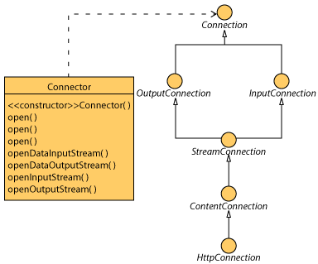
Case Study: Generic Connection Framework in MIDP 2.0
通用连接框架的设计目的是处理所有连接种类。在 MIDP 1.0 中，该框架受到限制，只能处理 HTTP 连接，MIDP 2.0 使用工厂设计模式增加了 HTTPS、串口连接、套接字和更多连接。
Notes:
容易扩充新的连接类型

Slide 19
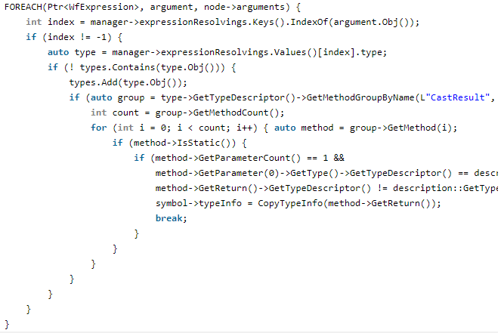
重构“箭头型”代码

Slide 20
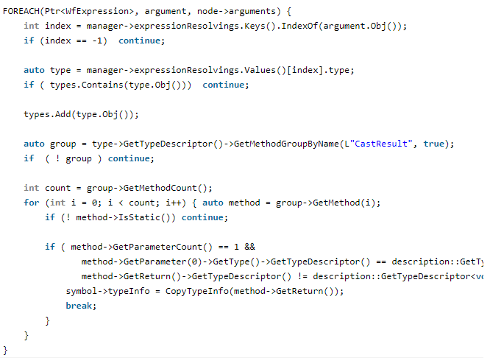
Guard Clauses
把条件反过来写，让出错的代码先返回，前面把所有的错误判断全判断掉，剩下的就是正常代码

Slide 21
微信Android模块化架构重构实践
架构回顾
出了什么问题？
重构模块

Slide 22
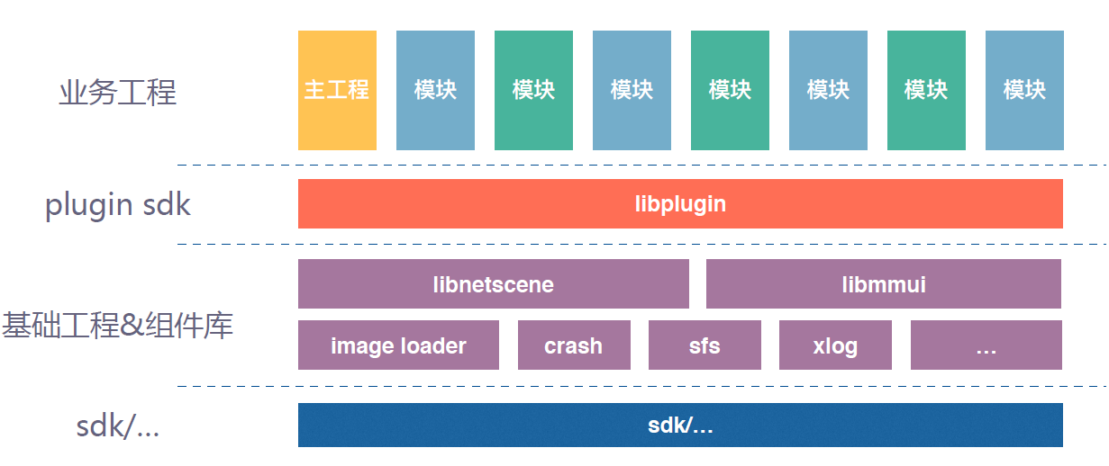
架构回顾

Slide 23
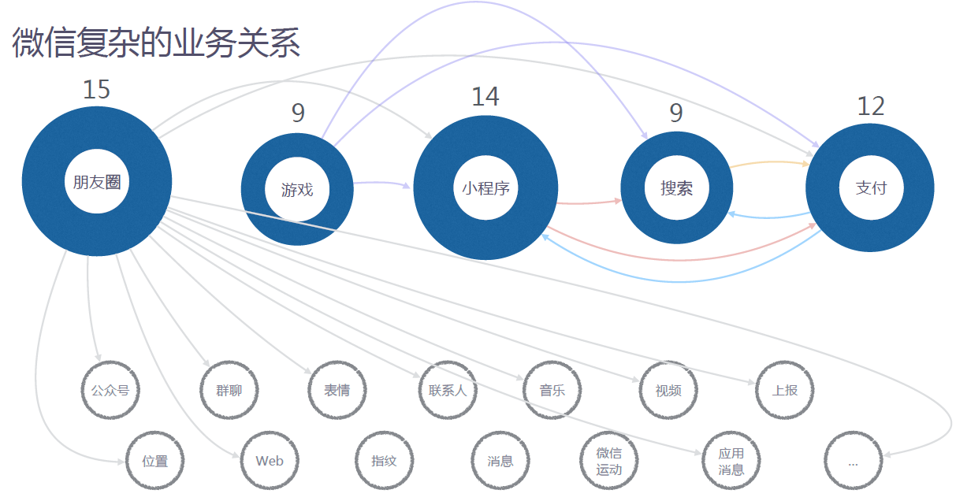
问题源头——复杂的业务

Slide 24
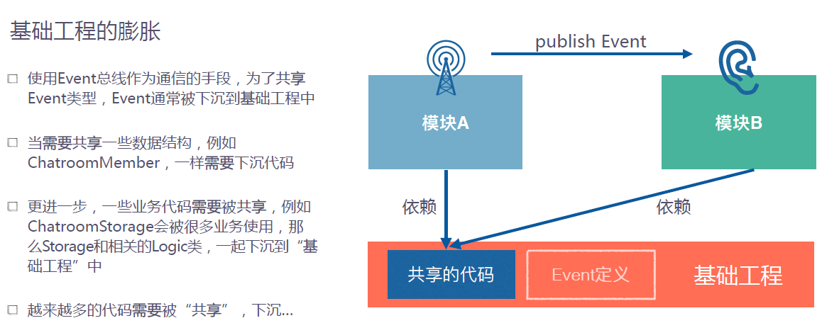
问题出在哪？

Slide 25
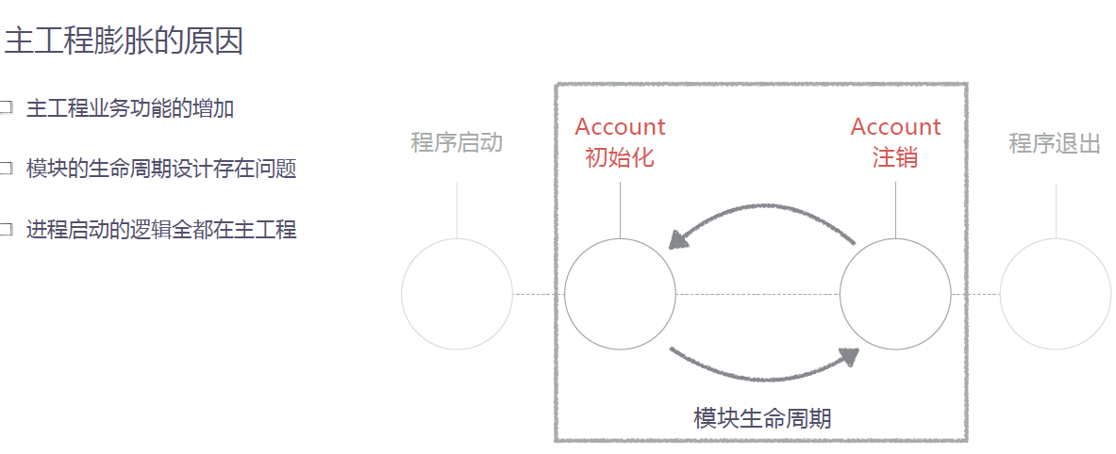
问题出在哪？

Slide 26
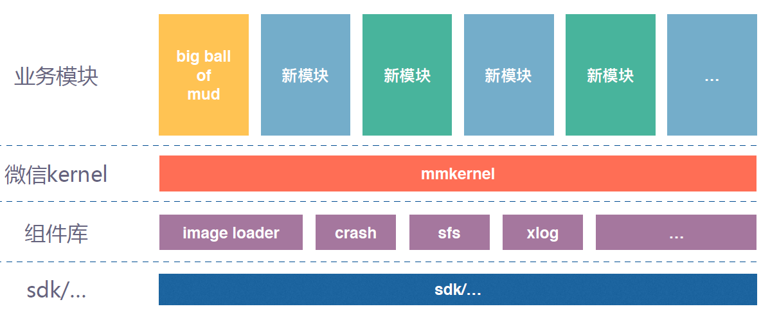
重构模块——分层结构改造

Slide 27
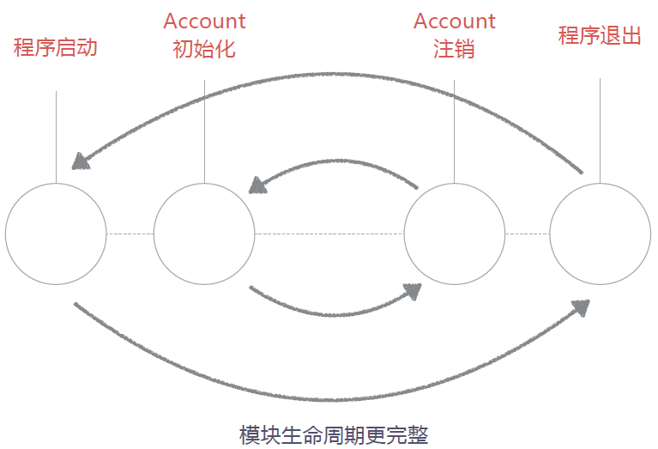
正确的生命周期

Slide 28
Summary
Modifiability deals with change and the cost in time or money of making a change, including the extent to which this modification affects other functions or quality attributes.
Tactics to reduce the cost of making a change include making modules smaller, increasing cohesion, and reducing coupling. Deferring binding will also reduce the cost of making a change.

